Slide 1
An Agile Solution
Aidan Gorospe
CS-250
Final Project
April 14, 2023

Slide 2
The small but stacking changes
The Agile Approach to software development revolves around making small changes to the product as they develop it, compared to one push after the other. Agile’s purpose is to deliver the product in a fast manner with less bugs or hiccups along the way. The small increments, or changes, allow the team to get feedback to change and improve their software quicklier and more efficiently.

Slide 3
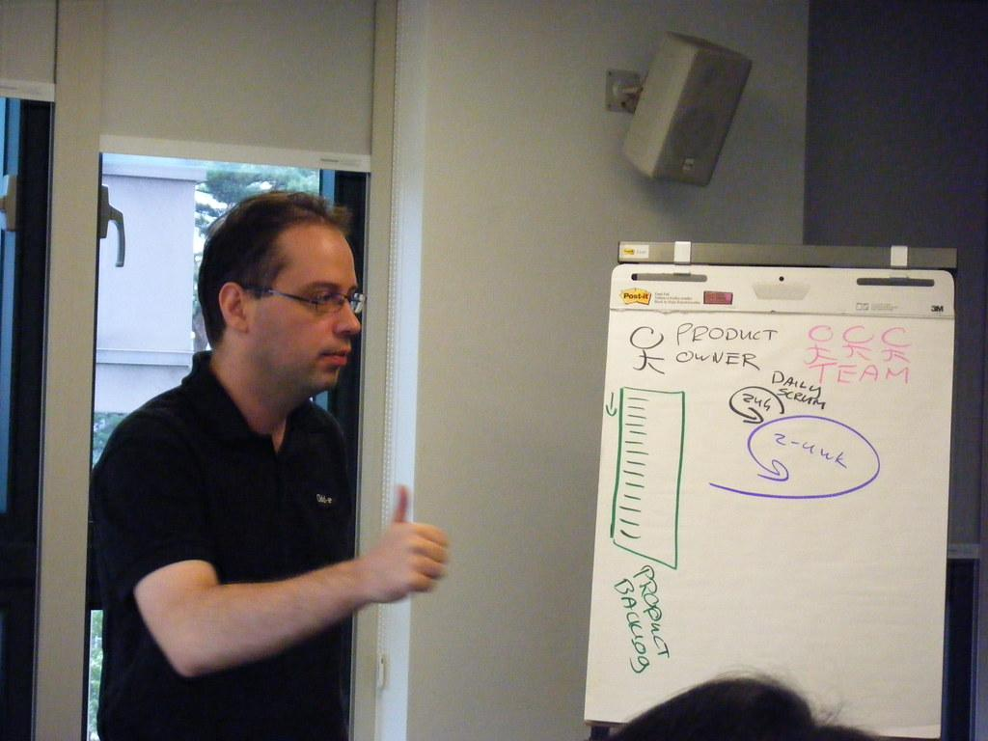
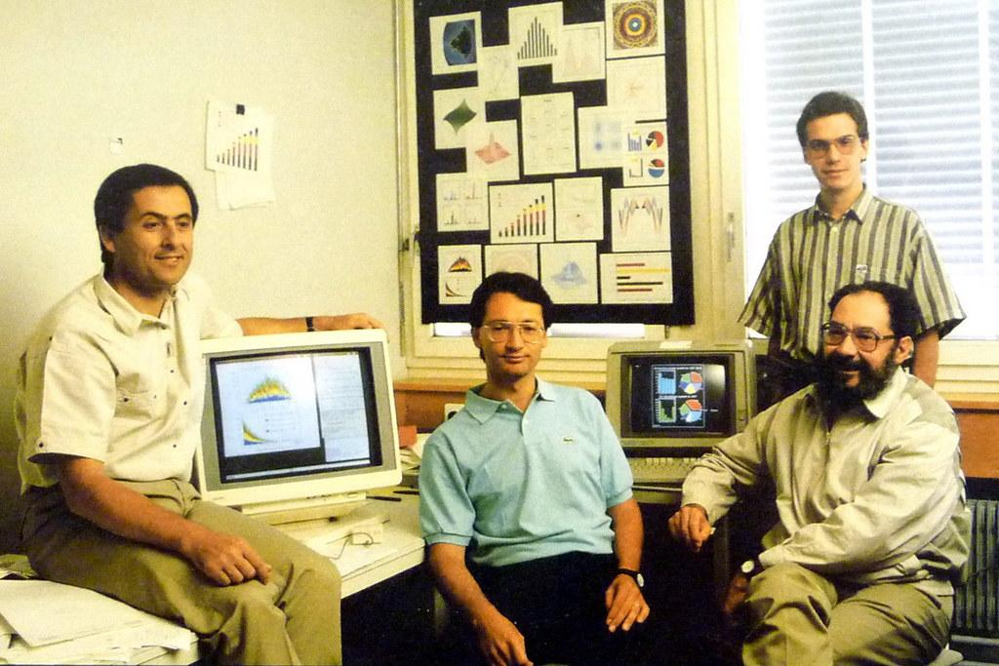

What makes up Agile?
The Main factors in making the Agile Development Cycle work are
Scrum Master Development Team Product Owner

Slide 4

Scrum Master
Communicates with the entire team, focuses on making a functional and cooperative working environment.
Manages team health and any impediments along the way.
Transfers Agile strategies and knowledge to the rest of the team

Slide 5

Development Team
No titles, just a team of people acting as one to improve morale.
Cross-functional, meaning the team can switch members depending on the situation, as they all have the required skills to make the product.

Slide 6
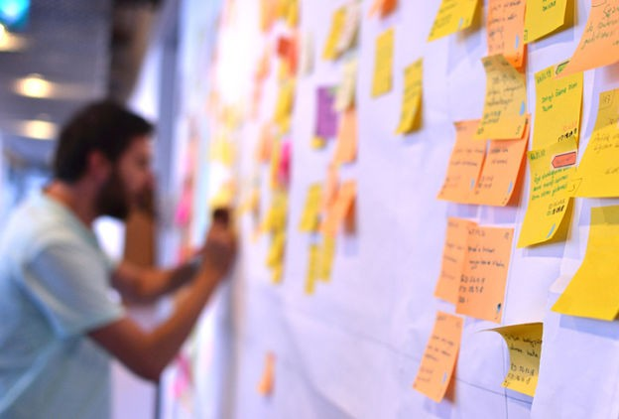
Product Owner
In charge of product’s vision, manages it and the backlog.
Talks to end-users and stakeholders to refine the backlog and create user stories.

Slide 7
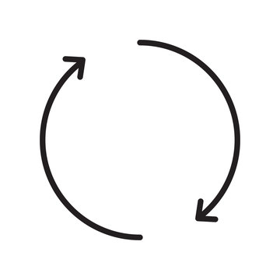
How does Agile apply in the SDLC?
Agile runs on a loop for each phase of product development. For each feature of the product, it is treated like a mini-product and has everyone working on the loop until that feature is completed. The cycle repeats until every bug has been stamped out, and the product is complete.

Slide 8
Agile vs Waterfall: What’s the difference
Agile:
Cyclical Approach
Easier to make Changes
Constant Feedback
Waterfall:
Straightforward Approach
Mostly already planned out, little room for changes
Little-to-no Feedback
To put it simply, treat Agile like a dash, and Waterfall like marathon. Agile has the team quickly completing smaller tasks and features that ultimately build the final product. Waterfall has the team essentially be given one task, where each feature is like a checkpoint.
Their use also still depends on the situation, as waterfall can be better than agile depending on the situation. When it comes to smaller time-frames with a short list of features, Waterfall could be the better approach. The opposite can be said with Agile.

Slide 9
References
Georgieff, M. (n.d.). Building your first agile team charter. Agile Marketing Guidance for Orgs, Teams, and Individuals. https://www.agilesherpas.com/blog/agile-team-charter.
Tutorials Point. (n.d.). SDLC - Agile Model. Retrieved October 14, 2021, from https://www.tutorialspoint.com/sdlc/sdlc_agile_model.html
Overeem, B. (2016, July). Characteristics of a great scrum team. Scrum.org. https://www.scrum.org/resources/characteristics-great-scrum-team-0.
Charter the team : Full scale agile™. Full Scale agile™ : Radical Agile. (2021, July 9). https://fullscaleagile.com/charter-the-team/#_Toc72418174.
Photos from Creative Commons and Photocase

